Slide 1
Dyads Types and Tie Properties

Slide 2
Levels of Analysis in social networks
Individual
1
Dyads
2
Triads
3
Cliques, Communities
4
Whole Network
5
The first part of the course follows this organization!

Slide 3
Levels of Analysis in social networks
Individual
Types and properties
1
Dyads
2
Triads
3
Cliques, Communities
4
Whole Network
5
The first part of the course follows this organization!

Slide 4

Dyads: Sociological classification (Borgatti et al.)
Pair of two vertices
Edge defined by a type of relationship or social tie
Borgatti, S. P., Mehra, A., Brass, D. J., & Labianca, G. (2009). Network analysis in the social sciences. Science, 323(5916), 892-895.

Slide 5
Dyads: Sociological classification (Kitts)
Role relations
  Friends, kin, business partners
Interpersonal sentiments and cognitions
  Liking, trusting, acquaintanceship
Behavioral Social Interactions
  Calling, texting, citing, supporting, resource exchange
Opportunity structure for exchange
  Structural holes, brokerage, intermediation
    “Non-ties” matter here
Kitts, J. A. (2014). Beyond networks in structural theories of exchange: Promises from computational social science. In Advances in Group Processes (pp. 263-298). Emerald Group Publishing Limited.

Slide 6
Dyad types: Combined Classification
Dyad Types
States
Events
Similarities
Relationships
Role Relations
Sentiments
Interactions
Propinquity
Memberships
Demographics
Cognitions
Communication
Exchanges

Slide 7
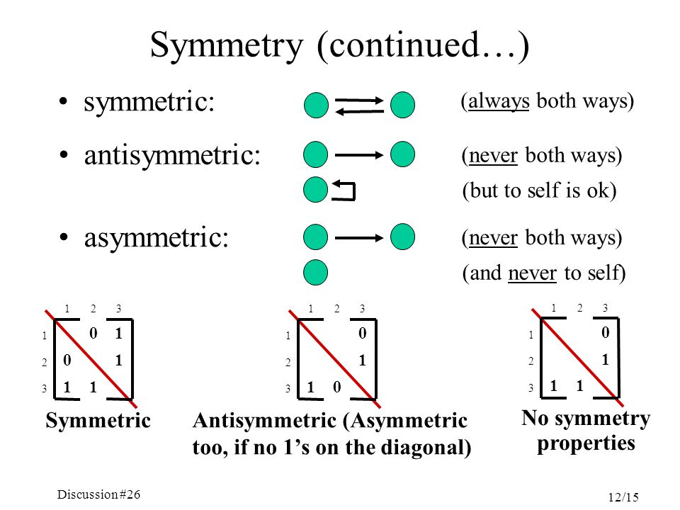
Dyad types: Graph theory classification
Symmetric
  If it exists, if a is linked to b, then b is necessarily linked to a
Asymmetric
  If it exists then if a is linked to b, then it is not a necessity that b is linked to a (but can happen)
Antisymmetric
  If it exists then is a is linked to b, then b cannot by necessity be linked to a

Slide 8
Linking sociological and graph theoretic types
Why the complication?
Different types of dyads have different graph theoretic properties:
  Similarities (propinquity, memberships) are by necessity symmetric
  Some role relations are by necessity symmetric:
    Being somebody’s friend
    Being somebody’s brother
  Other role relations are by necessity anti-symmetric:
    Being somebody’s boss
    Being somebody’s parent
  Some relationships (e.g., cognitive, affective) are necessarily asymmetric
    You can text without being texted back
  Interaction and exchanges are necessarily asymmetric
    You can give advice without receiving it

Slide 9
Linking sociological and graph theoretic types
Propinquity
Similarities
Demographics
Memberships
Role Relations
Relationships
Cognitions
Sentiments
Interactions
Events
Communication
Exchanges

Slide 10





Types of
Social Ties
Symmetric
Asymmetric
Antisymmetric
Reciprocal
Non-Reciprocal
Summary: Dyads

Slide 11
Symmetric kin (being a sibling of)
1st Generation
Antisymmetric kin (parent of, uncle of)
Second Generation
In Families:
  Same generation ties are symmetric
    Sibling/Cousin
  Cross-Generation ties antisymmetric
    Parent/Uncle/Parent’s parent
Third Generation
Dyads: Linking sociological and graph theoretic types

Slide 12
Symmetric work (coworker, officemate)
Executives
Antisymmetric work (boss, supervisor)
Managers
In Hierarchies or Organizations:
  Same authority level ties are symmetric
  Cross-Authority level ties antisymmetric
Workers
Linking sociological and graph theoretic types

Slide 13
Symmetric work (coworker, officemate)
a
Executives
Antisymmetric work (boss, supervisor)
Pure hierarchy implies transitivity
Transitivity is a relation between node triples
  If a has authority over b, and b has authority over c
  Then a necessarily has authority over c
b
This edge (ac) has to exist!
Managers
c
Workers
a
b
Linking sociological and graph theoretic types
c

Slide 14
Symmetric kin (being a sibling of)
a
1st Generation
Antisymmetric kin (parent of, uncle of)
b
Transitivity also applies to family ties:
  If a is related to b and b is related to c
  Then a is necessarily related to c
Second Generation
c
Third Generation
a
b
Dyads: link between social meaning and graph theoretic properties
c

Slide 15
Symmetric work (coworker, officemate)
Executives
Antisymmetric work (boss, supervisor)
Asymmetric work (like, dislike)
Managers
People are usually linked by different types of ties at the same time
  This is called multiplexity
Example:
  People joined via a either symmetric or antisymmetric role relations (e.g., supervisor)
  Can also be linked via an asymmetric sentiment relation (liking, disliking)
Workers
Dyad properties: Multiplexity

Slide 16
Symmetric kin (being a sibling of)
Gma
1st Generation
Antisymmetric kin (parent of, uncle of)
Asymmetric kin (like, dislike)
Mom
Unc
People are usually linked by different types of ties at the same time
  This is called multiplexity
Example:
  People joined via a either symmetric or antisymmetric role relations (e.g., kin ties)
  Can be linked via an asymmetric social support relation
Second Generation
You
Sis
Third Generation
Dyad properties: Multiplexity

Slide 17
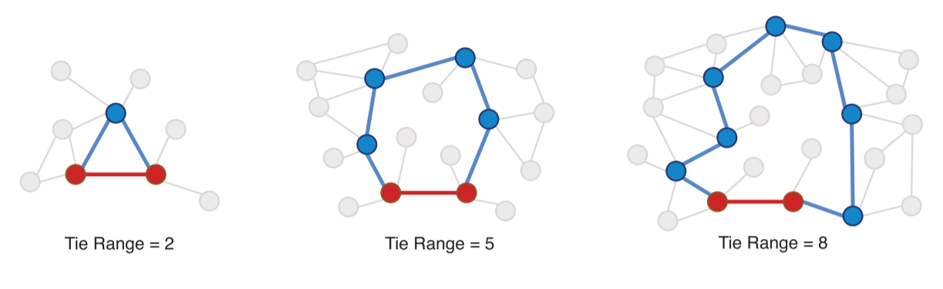
Dyad properties: Range
The range of tie is given by the second shortest path connecting the nodes in a dyad
Range is a non-local property
  Depends on other links beyond the dyad

Slide 18
Dyads properties: Bandwidth
https://www.sciencedirect.com/science/article/pii/S0378873318300194

Slide 19
Symmetric kin (being a sibling of)
Antisymmetric kin (parent of, uncle of)
Family 1
Family 2
Asymmetric non-kin (romantic)
Parent
Parent
Parent
Parent
You and Riley are in love: Yay!
You
Sis
Riley
Bro
Dyads: Different types of ties concatenate in different ways

Slide 20
Symmetric kin (being a sibling of)
Antisymmetric kin (parent of, uncle of)
Family 1
Family 2
Asymmetric non-kin (romantic)
Parent
Parent
Parent
Parent
You and Riley are in love: Yay!
You and Riley got married: Awesome!
You
Sis
Riley
Bro
Dyads: Different types of ties concatenate in different ways

Slide 21
Symmetric kin (being a sibling of)
Antisymmetric kin (parent of, uncle of)
Family 1
Family 2
Asymmetric non-kin (romantic)
Parent
Parent
Parent
Parent
Whoops! Things are getting complicated: “In law” ties
Both symmetric (sibling in law) and anti-symmetric (son in law)
You
Sis
Riley
Bro
Dyads: Different types of ties concatenate in different ways

Slide 22
Family 1
Family 2
Symmetric kin (being a sibling of)
Antisymmetric kin (parent of, uncle of)
Parent
Parent
Parent
Parent
Asymmetric non-kin (romantic)
You and Riley had a baby. Great!
You
Sis
Riley
Bro
Baby
Dyads: Different types of ties concatenate in different ways

Slide 23
Family 1
Family 2
Symmetric kin (being a sibling of)
Antisymmetric kin (parent of, uncle of)
Parent
Parent
Parent
Parent
Asymmetric non-kin (romantic)
Argh. More complication!
Baby has an anti-symmetric kin tie to everyone (grandson/daughter, niece/nephew, etc.)
You
Sis
Riley
Bro
Baby
Dyads: Different types of ties concatenate in different ways

Slide 24
Dyad properties: Strength
Tie Strength
Duration
Time Spent Together
Emotional Intensity
Intimacy/Confiding
Interaction Freq.
Similarities
Sentiment
Exchanges
Communication
“The strength of a tie is a...combination of the amount of time, the emotional intensity, the intimacy (mutual confiding) and the reciprocal services which characterize the tie” (Granovetter 1973: 1361).

Slide 25
How do you measure tie strength?
One approach: Use role relations as a proxy for strength
  Family and Friends are strong ties, acquaintances, co-workers, and neighbors are weak ties
  What’s the problem with this?
Another approach: Use interaction frequencies as a proxy for strength:
  People you see or interact with frequently are strong ties, people who you do not see or interact with frequently are weak ties
  What’s the problem with this?
Yet another approach: Use the number of different types of ties linking people as a proxy for strength:
  Multiplex ties are strong and “uniplex” ties are weak
  What’s the problem with this?

Slide 26
How do you measure tie strength?
Predictors
Best approach:
  Marsden and Campbell’s (1984) Indicator/Predictor Model
Combines different criteria
Distinguishes between tie properties that:
  Predict Strength (Predictors)
  Are Caused by Strength (Indicators)
Role Relations
Similarities
Tie Strength
Sentiment
Interaction
Exchange
Indicators

Slide 27
How do you measure tie strength?
Predictors
Best approach:
  Marsden and Campbell’s (1984) Indicator/Predictor Model
Indicators:
  Closeness/Intimacy (Sentiments)
  Frequency (Interaction)
  Duration
  Exchange/Support (Exchange)
Predictors:
  Role relations (Friend, Co-worker)
  Common memberships and Social Position (Similarities)
Role Relations
Similarities
Tie Strength
Sentiment
Interaction
Exchange
Indicators

Slide 28
How do you measure tie strength?
Predictors
Best approach:
  Marsden and Campbell’s (1984) Indicator/Predictor Model
Predictors tell us that a strong tie is more or less likely to form
  E.g., people who are similar are more likely to form strong ties
Indicators tell us that an existing tie is more or less strong
  The more indicators the stronger
    Closeness + Interaction + Support
Role Relations
Similarities
Tie Strength
Sentiment
Interaction
Exchange
Indicators

Slide 29

Weighted graphs
Often it is useful to associate numerical values with the edges (uv) of a graph:
  This is called the edge weight (w_{uv})
    The strength of the relationship j
    the amount of something (e.g. information, support) that flows
Graphs that featured edge weights are called weighted (valued) graphs:
  Binary graphs can be thought of as a constrained case of weighted graphs

Slide 30
Weighted graphs
Often it is useful to associate numerical values with the edges (uv) of a graph:
  This is called the edge weight (w_{uv})
    The strength of the relationship j
    the amount of something (e.g. information, support) that flows
Sometimes people “binarize” weighted graphs using a cutoff to simplify analysis
  a_{ij} = 1 if w_{ij} > ϴ, else a_{ij} = 0
Weighted graphs can be directed or undirected
Weighted Directed Graph

Slide 31
Weighted graphs: Matrix Representation
 | a | b | c | d | e | f
a | --
b |  | --
c |  |  | --
d |  |  |  | --
e |  |  |  |  | --
f
Weighted Directed Graph

Slide 32
Weighted graphs: Matrix Representation
 | a | b | c | d | e | f
a | -- | 0 | 0 | 0 | 0.1 | 0.9
b | 0.3 | -- | 0.3 | 0.4 | 0 | 0
c | 0 | 0 | -- | 0.6 | 0.4 | 0
d | 0 | 0 | 0 | -- | 1.0 | 0
e | 0.55 | 0 | 0 | 0 | -- | 0.45
f | 0 | 0 | 0 | 1.0 | 0 | --
Weighted Directed Graph

